Slide 1
Quantitative HSR I
Lecture 7: Endogeneity & Instrumental Variables
March 2, 2026
HAD5744 • Alex Hoagland, Ph.D.
Notes:
Notes:
we have 2 case studies here, but there’s also a lot of new ideas here so we will go through multiple examples
Also, there won’t be that much coding (it’s easy to implement in the code we already have!) the important things we’ll cover are (a) how to come up with an instrument and defend it and (b) the role of robustness checks/ancillary evidence/descriptive results as support for this approach.
I added another referee paper to the list

Slide 2
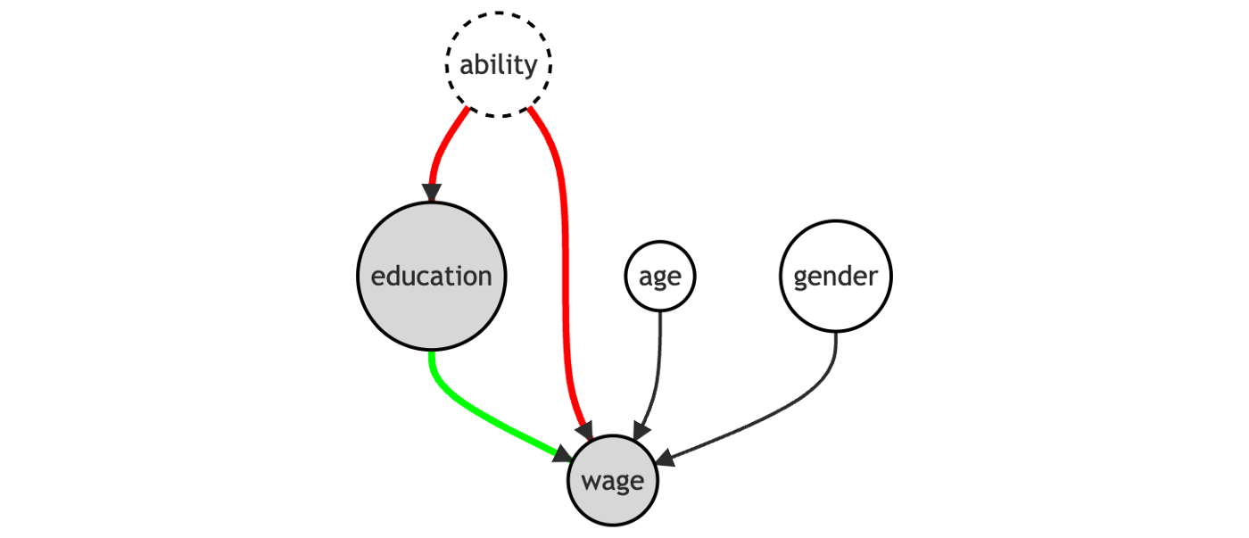
Last Time: Matching Approaches
Matching methods help to deal with imbalanced data
Helps you argue that your comparisons really are apples-to-apples
Matching relies on selection on observables
Propensity score, nearest neighbor techniques
Notes:
So far, we’ve focused on the backdoor criterion – can we close paths that stand in our way? Matching and controlling for covariates are two primary approaches.

Slide 3
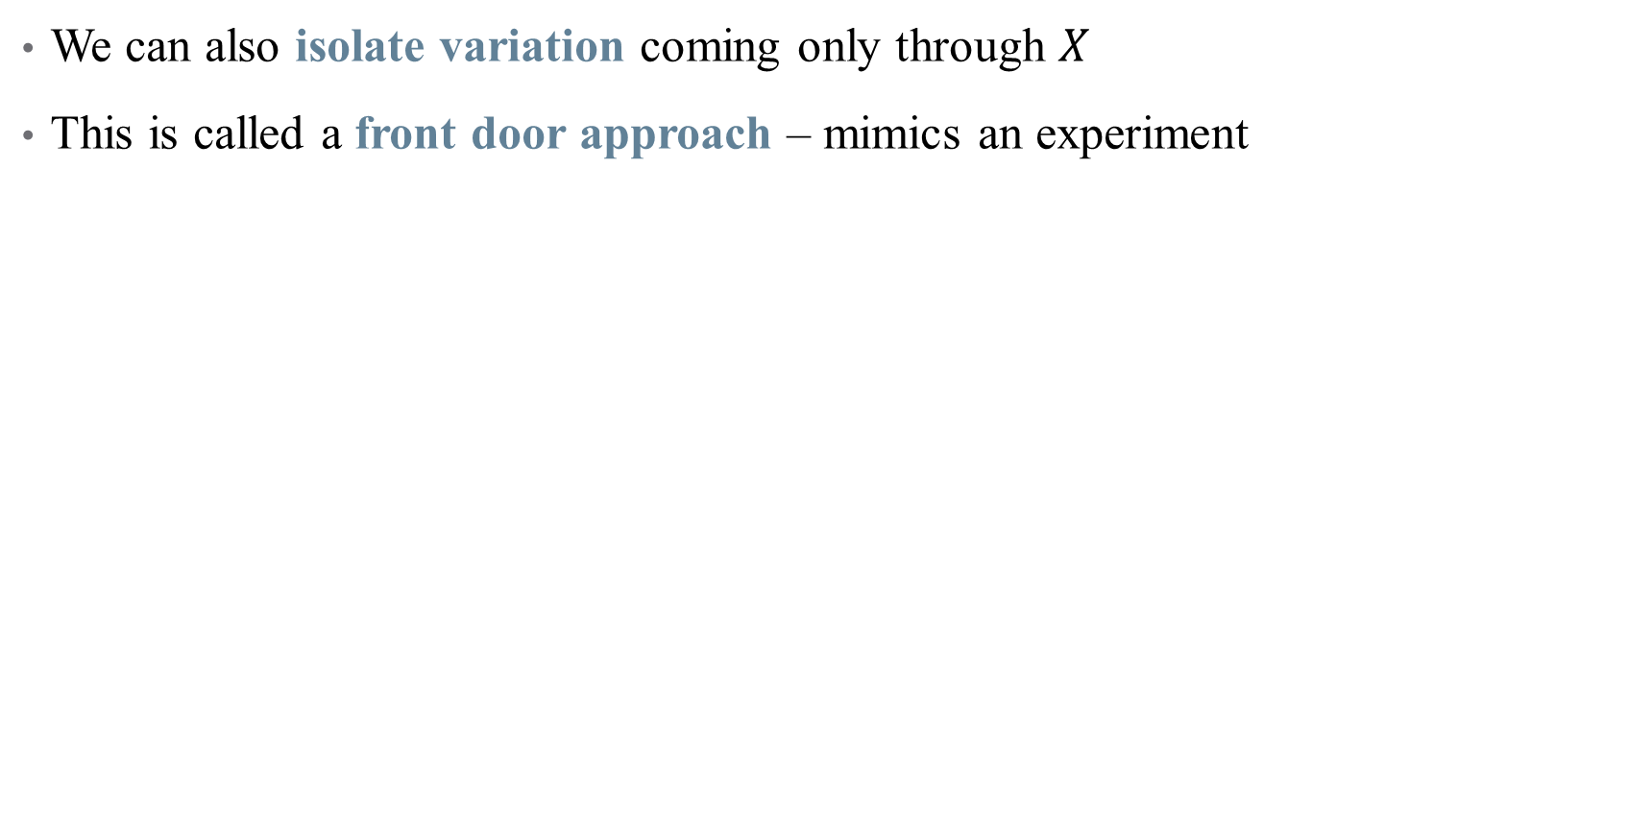
Causal Inference: From Back Doors to Front
We can also isolate variation coming only through $X$
This is called a front door approach – mimics an experiment
Notes:
This dag cannot be addressed fully with a back-door approach (how do we ever measure ability)? The front door finds an instrument M such that there is no back door between education and M, and education blocks the only open back-door between M and wage (ability). This is an open door! Example of M: quarter of birth (Angrist and Kreuger, 1991). M goes behind education and connects to it.

Slide 4

Open up the (Right) Gates!
Notes:
Lots of frozen in our house these days, so I want this playing in all of our heads.

Slide 5
Case Study

Slide 6
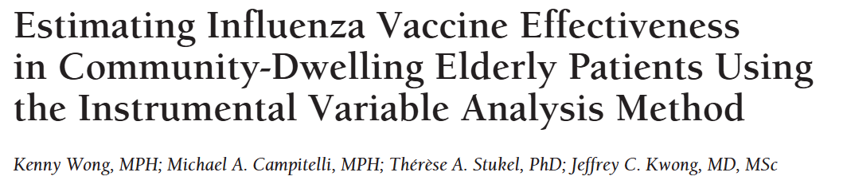
Example: causal effect of vaccines
Why would estimating the effect of a vaccine be hard in observational data?
If you looked at a “naïve” estimate of vaccine effectiveness, what direction would you expect it to be biased? Why?
Notes:
Recommend looking at the related invited commentary as well to get a sense of this better. https://jamanetwork.com/journals/jamainternalmedicine/article-abstract/1108791

Slide 7
Example: causal effect of vaccines
Why would estimating the effect of a vaccine be hard in observational data?
If you looked at a “naïve” estimate of vaccine effectiveness, what direction would you expect it to be biased? Why?
“Even after statistical control for various demographic variables and other medical conditions, elderly patients who receive the vaccine appear to be much healthier than apparently comparable unvaccinated patients. Strong evidence of this bias comes from an important epidemiologic study by Jackson et al² in which the authors reported that a large beneficial effect of the vaccine is apparent before the influenza season begins.”
Notes:
Recommend looking at the related invited commentary as well to get a sense of this better. https://jamanetwork.com/journals/jamainternalmedicine/article-abstract/1108791

Slide 8
Example: causal effect of vaccines
Why would estimating the effect of a vaccine be hard in observational data?
If you looked at a “naïve” estimate of vaccine effectiveness, what direction would you expect it to be biased? Why?
What does this study look at (outcomes, population)?
What is the selection problem that they are addressing? Why is this endogeneity?
Note: abstract says “uses logistic regression IV to remove the effect of selection bias” is not correct. Also says “IV methods control for overt and hidden biases in observational studies.” This is also not correct
What we are doing is approximating a quasi-experiment and identifying a causal effect if that approximation is done correctly
Notes:
Note: if you want the correct way to talk about this, you need to read an economics paper. Like the dialysis one. Very careful with language even though everyone else hates us for it.

Slide 9
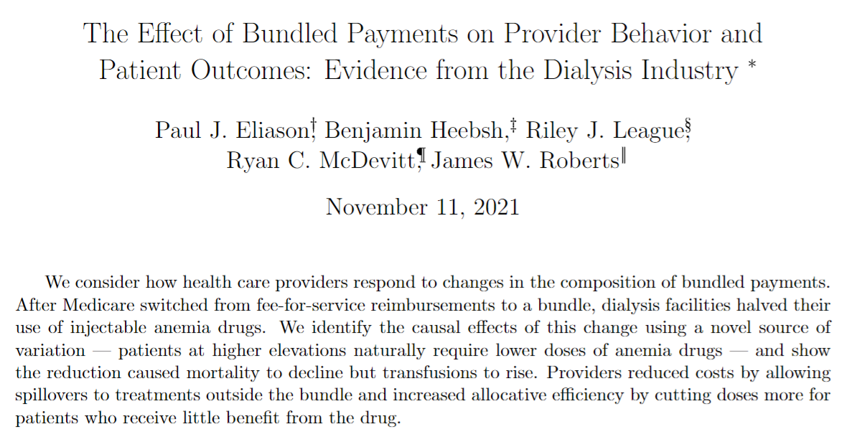
Example: Waiting Times and Transplantation Outcomes
Notes:
Note: look how long it took this paper to publish! Okay, so what’s the open back door? What’s the DAG here? What is the “natural experiment” they are exploiting? We’ll talk about why this works (maybe). Start with outcome variable (2), then exposure (bundled payment/use of drugs), then IV (altitude + post-bundle indicator). What endogeneity are they dealing with (strategic decision-making on the part of the doctors).

Slide 10
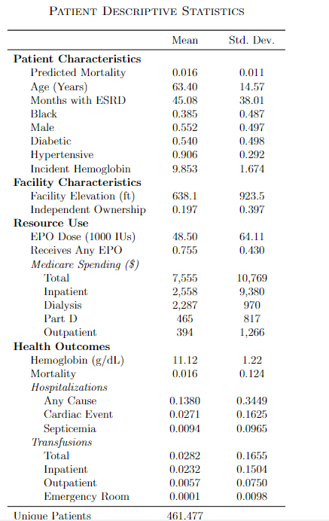
Case study: what is the reform?
Data and summary statistics
U.S. Renal Data System: Medicare claims, treatment histories, patient attributes, and annual facility surveys
Notes:
Yay for descriptive evidence!

Slide 11
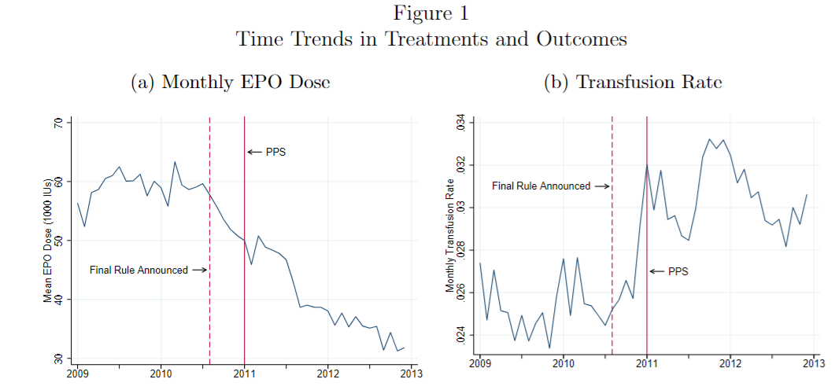
Case study: what is the reform?
Data and summary statistics
U.S. Renal Data System: Medicare claims, treatment histories, patient attributes, and annual facility surveys
Reform bundled Medicare payments for dialysis sessions and injectable drugs
Notes:
Yay for descriptive evidence! There are other panels to Figure 1 not pictured. For example, dialysis doesn’t change. What is the hypothesis? Figure EPOs lead to more transfusions, since EPO doses and transfusions are used to treat anemia

Slide 12
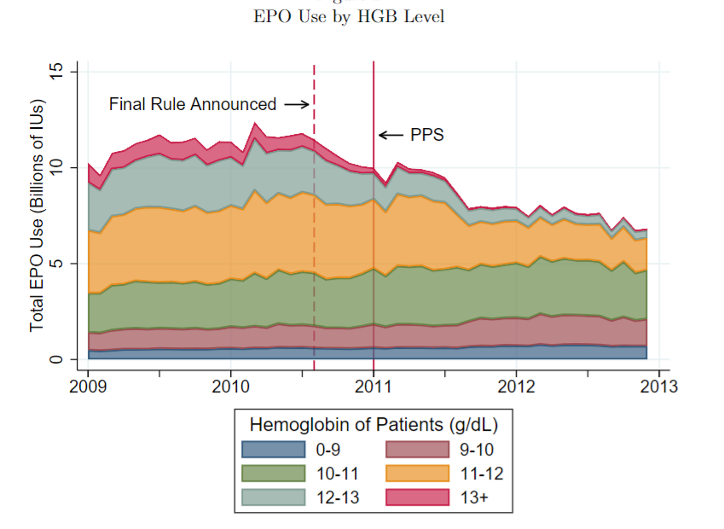
Case study: what is the reform?
Notes:
Declines are largest for those with the highest hemoglobin patients (least anemic). Does this make sense? What’s the story? “Allocative efficiency may have improved following the bundle as providers concentrated the decrease in EPO among patients who were previously receiving doses that put their HGB levels above the recommended range” (what does this mean in non-econ speak?)

Slide 13
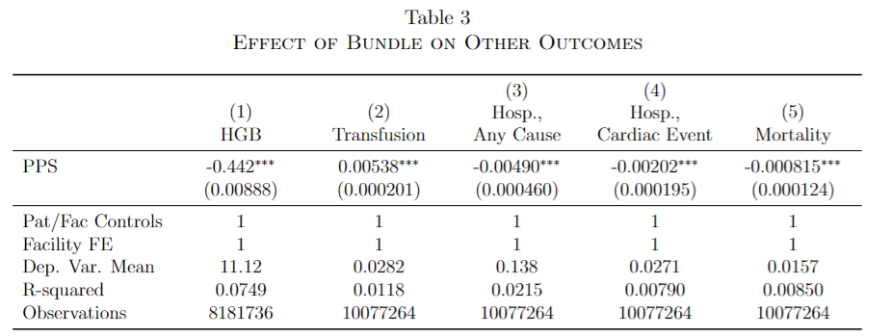
Case study: what is the reform?
But what if EPO doses are endogenously chosen by facilities/patients?
Notes:
What does the OLS say? Why are we worried about endogeneity here? Larger EPO doses should raise hemoglobin, that’s the point!

Slide 14
Endogeneity
Notes:
This is the right way to discuss IV: what things directly lead to the outcome on their own (exogenous), and what things are jointly determined in a more complex system (endogenous)?

Slide 15
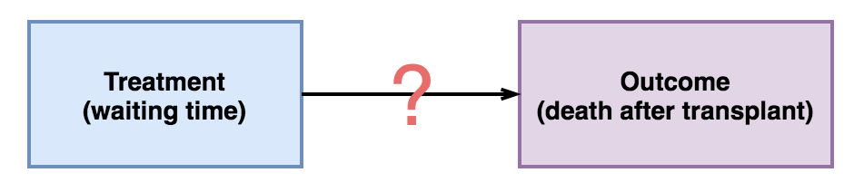
Example: Waiting Times and Transplantation Outcomes
Notes:
Let’s start with just part of the story: the effect of shortening waiting times for transplants on positive outcomes. We can’t randomize this (why?)
But we also can’t just use observational data in a simple regression (why? – selection! patients who are more likely to have poor outcomes may also have different waiting times)

Slide 16
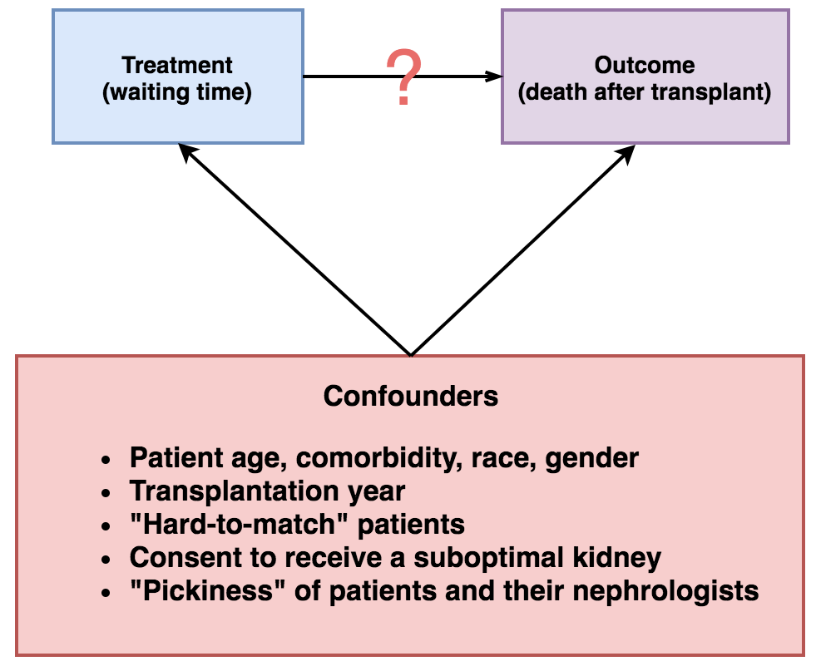
Example: Waiting Times and Transplantation Outcomes
Notes:
Examples of selection – note that not all of these confounders are things we can deal with.

Slide 17
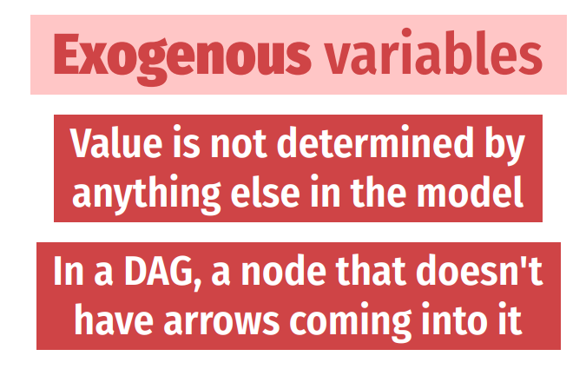
Exogeneity + Endogeneity
Notes:
Exogenous variables: age, demographics. What about education? Whether or not you need a transplant in the first place? This starts to become a gray area quickly.

Slide 18
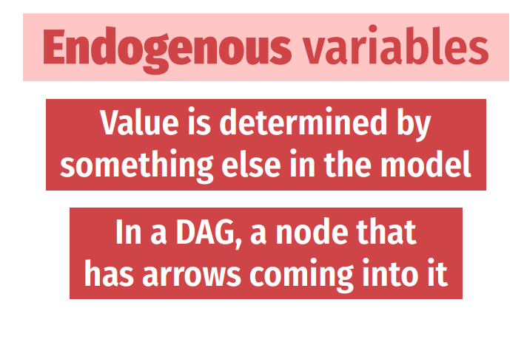
Exogeneity + Endogeneity
Notes:
Things that are almost surely endogenous: health outcomes, decision to seek care, etc. (any y of interest also)

Slide 19
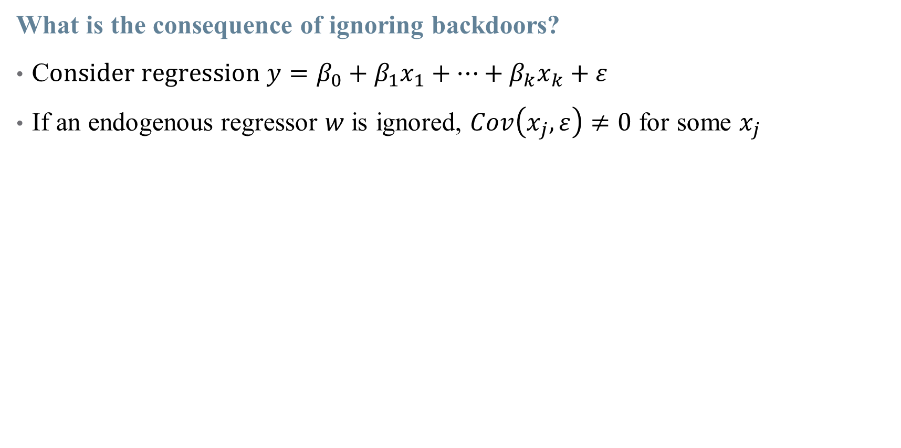
Endogeneity
What is the consequence of ignoring backdoors?
C$onsider regression y=β_{0}+β_{1}x_{1}+…+β_{k}x_{k}+ε$
If an endogenous regressor $w$is ignored, $Cov\left(x_{j},ε\right)≠0$ for some $x_{j}$
Notes:
One version of endogeneity is OVB with an unmeasurable variable --- others include jointly determined variables, or strategic selection.

Slide 20
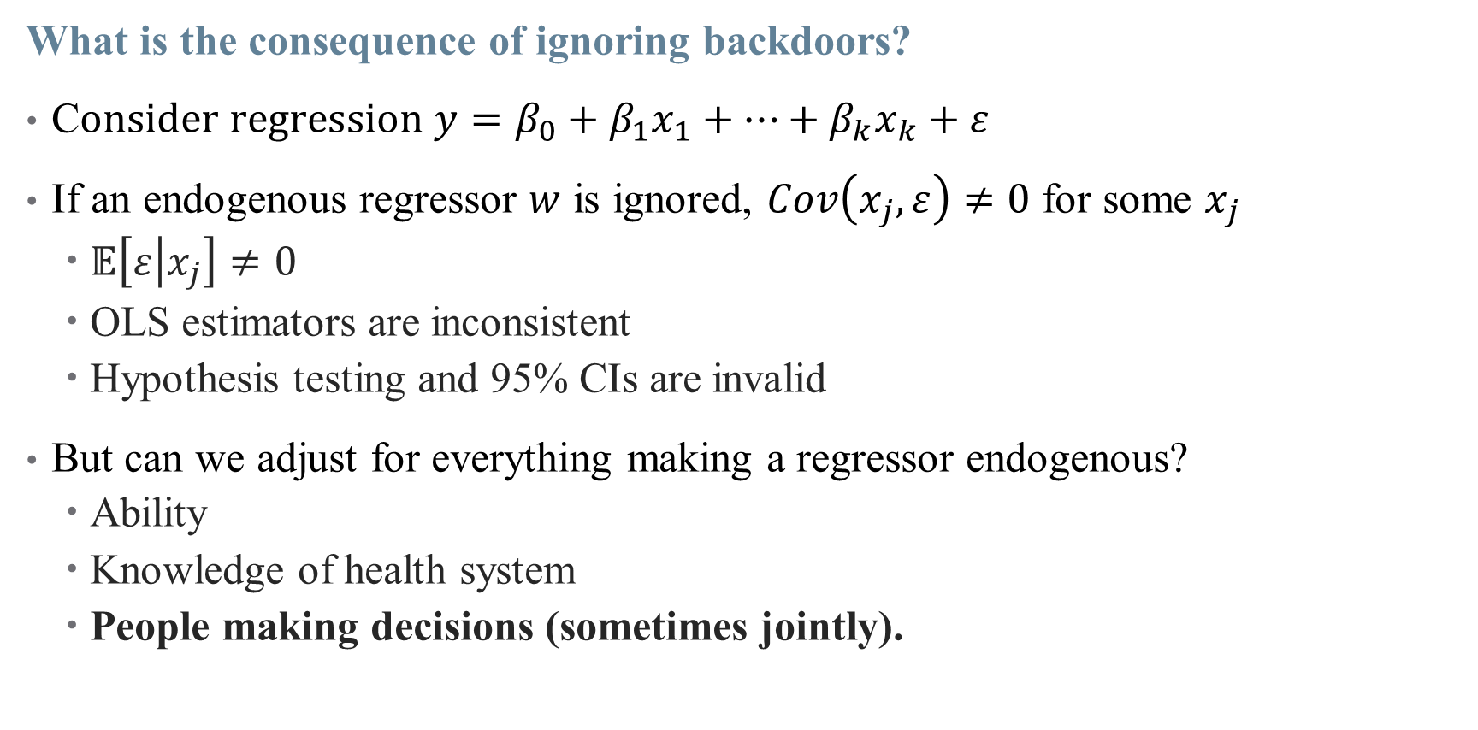
Endogeneity
What is the consequence of ignoring backdoors?
C$onsider regression y=β_{0}+β_{1}x_{1}+…+β_{k}x_{k}+ε$
If an endogenous regressor $w$ is ignored, $Cov\left(x_{j},ε\right)≠0$ for some $x_{j}$
$𝔼\left[ε | x_{j}\right]≠0$
OLS estimators are inconsistent
Hypothesis testing and 95% CIs are invalid
But can we adjust for everything making a regressor endogenous?
Ability
Knowledge of health system
People making decisions (sometimes jointly).
Notes:
Moving health knowledge out of the error term could make decision to seek care an exogenous variable – but how do we measure that? But not all back doors can be closed! Without perfect data or randomization, we can’t make everything exogenous by shutting down a backdoor.

Slide 21
Endogeneity
What is the consequence of ignoring backdoors?
C$onsider regression y=β_{0}+β_{1}x_{1}+…+β_{k}x_{k}+ε$
If an endogenous regressor $w$ is ignored, $Cov\left(x_{j},ε\right)≠0$ for some $x_{j}$
$𝔼\left[ε | x_{j}\right]≠0$
OLS estimators are inconsistent
Hypothesis testing and 95% CIs are invalid
But can we adjust for everything making a regressor endogenous?
Ability
Knowledge of health system
People making decisions (sometimes jointly).
This isn’t just a problem of not having the right variables in your data set, you can’t control for this stuff!
Notes:
Moving health knowledge out of the error term could make decision to seek care an exogenous variable – but how do we measure that? But not all back doors can be closed! Without perfect data or randomization, we can’t make everything exogenous by shutting down a backdoor.

Slide 22
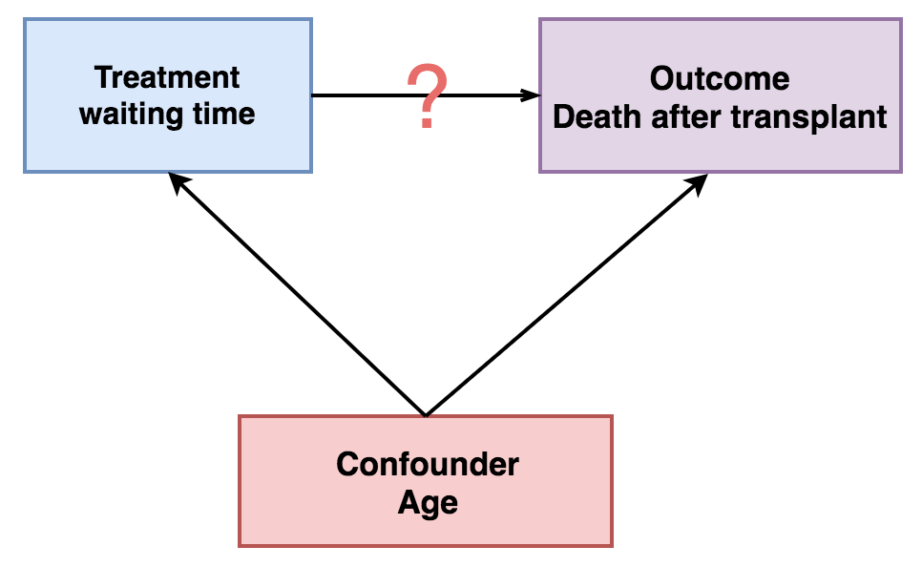
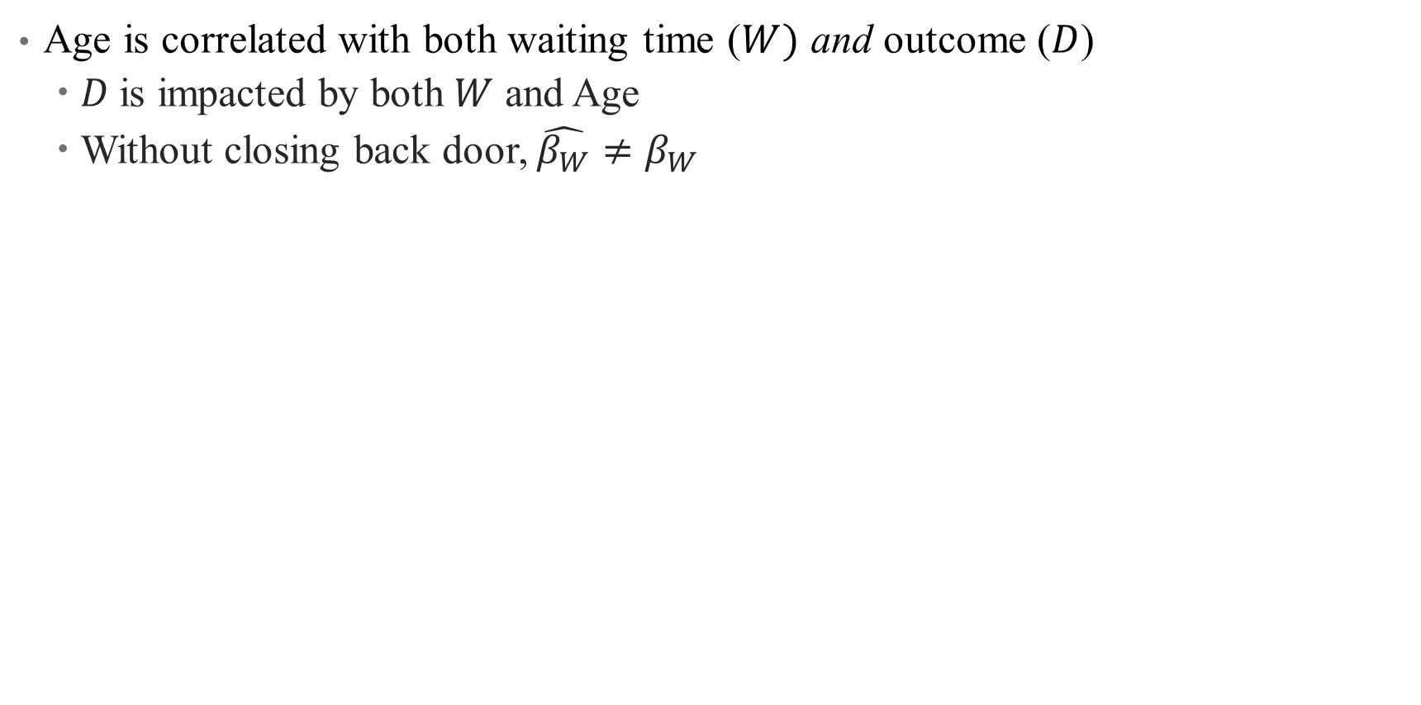
Exogeneity Example: Age
Age is correlated with both waiting time ($W)$ and outcome ($D$)
$D$is impacted by both $W$ and Age
Without closing back door, $\hat{β_{W}}≠β_{W}$

Slide 23
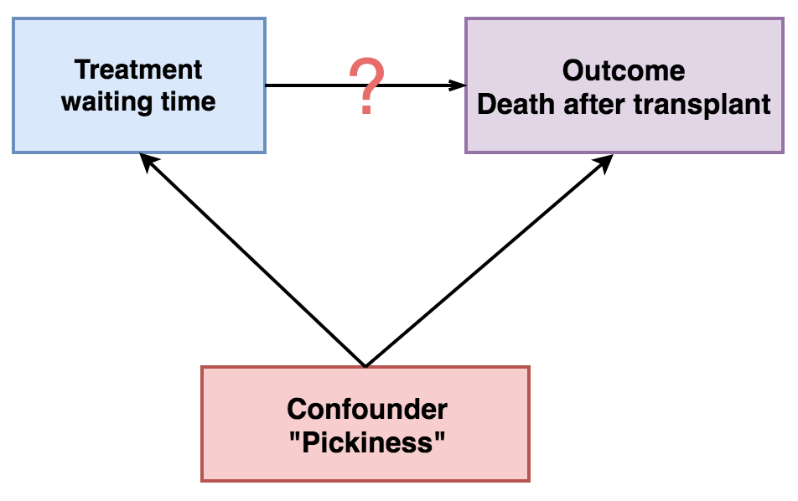
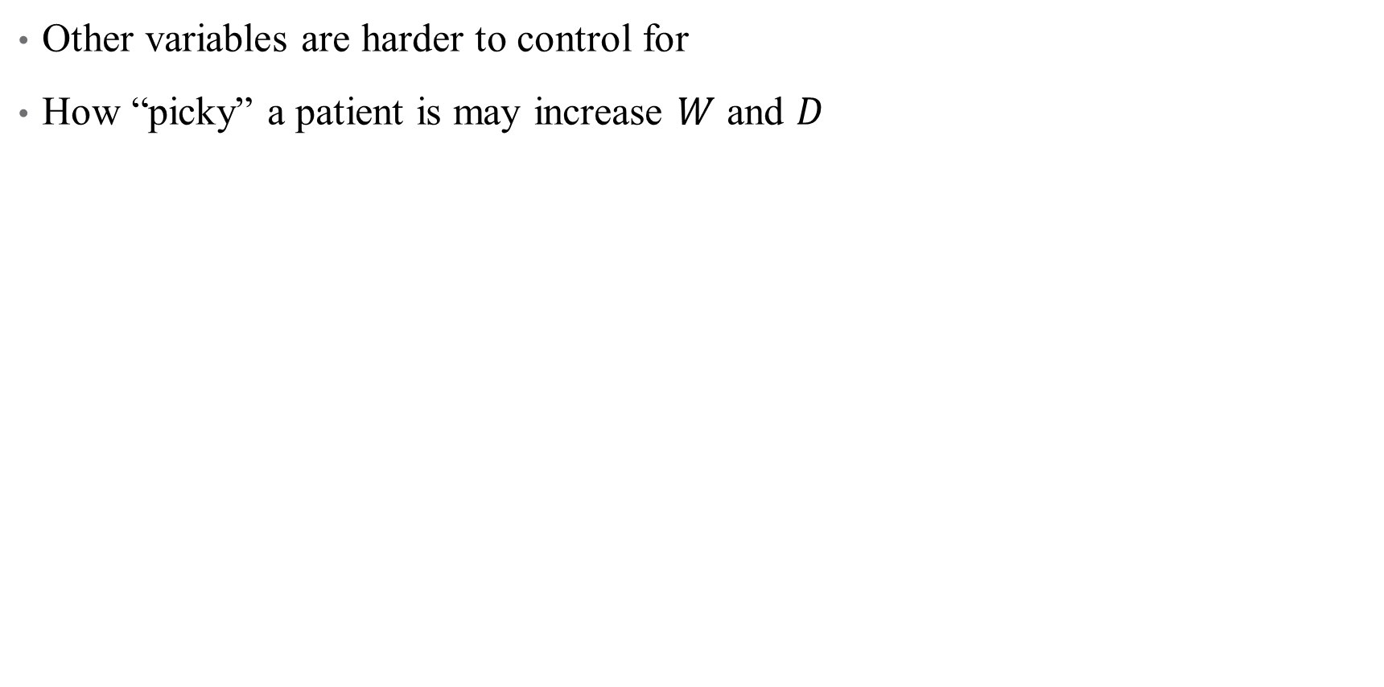
Endogeneity Example: “Pickiness”
Other variables are harder to control for
How “picky” a patient is may increase $W$ and $D$
Notes:
What do we do when endogeneity threatens our main treatment of interest? Our approach today is what we resort to when we can’t close all backdoors – we take a front door approach and simulate randomization

Slide 24
Endogeneity Example: “Pickiness”
Other variables are harder to control for
How “picky” a patient is may increase $W$ and $D$
What’s the endogeneity in our case study?
Notes:
Walk through this one more time. Then walk through the dialysis example?

Slide 25
Exploiting Quasi-Random Variation

Slide 26
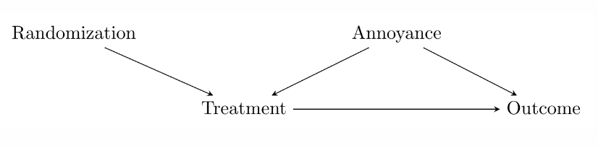
Causal Inference: From Back Doors to Front
Back door variation stands in the way of causal inference
But we can avoid that through careful randomization
Notes:
In an experiment, we generate variation (random assignment) and then just isolate the part of the treatment driven by that random variation (we compare across treatment and control groups). IV does the same, except isolating the part of the treatment driven by quasi-random, natural circumstances – the instrument.

Slide 27
Causal Inference: From Back Doors to Front
Back door variation stands in the way of causal inference
What if we didn’t assign randomization? Can we simulate it somehow?
Instrumental Variables looks for real-world (quasi)-randomization

Slide 28
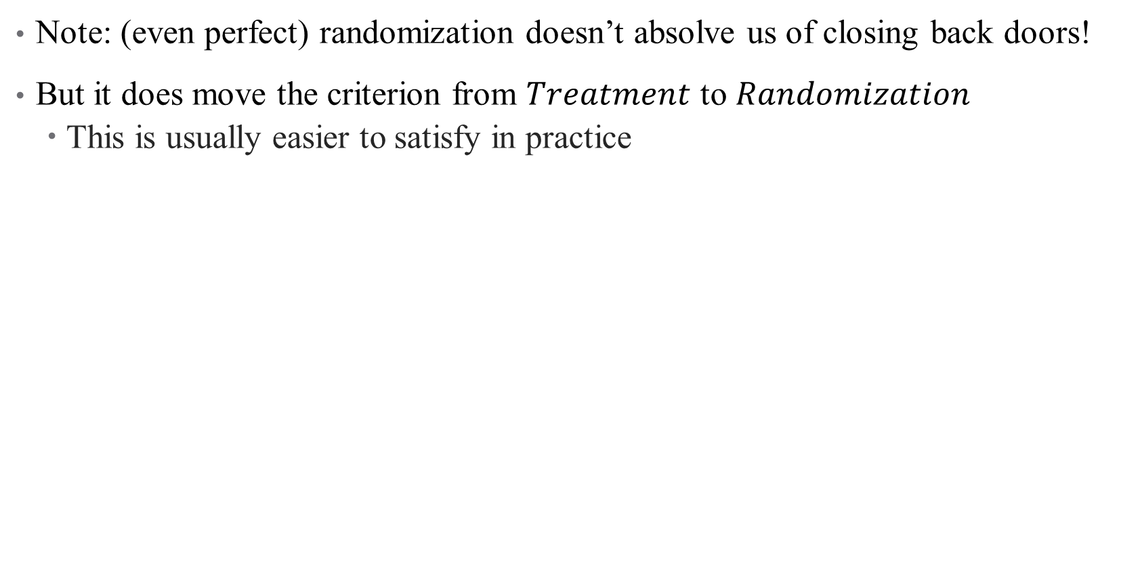
Causal Inference: From Back Doors to Front
Note: (even perfect) randomization doesn’t absolve us of closing back doors!
But it does move the criterion from $Treatment$ to $Randomization$
This is usually easier to satisfy in practice
Notes:
So we: (1) use the instrument to explain the treatment, (2) focus only on the part of the treatment explained by the instrument, and (3) use that to look at the instrument-explained part of the outcome. Basically, we’re splitting the effect of treatment into its endogenous and exogenous parts, and isolating just the exogenous part.

Slide 29
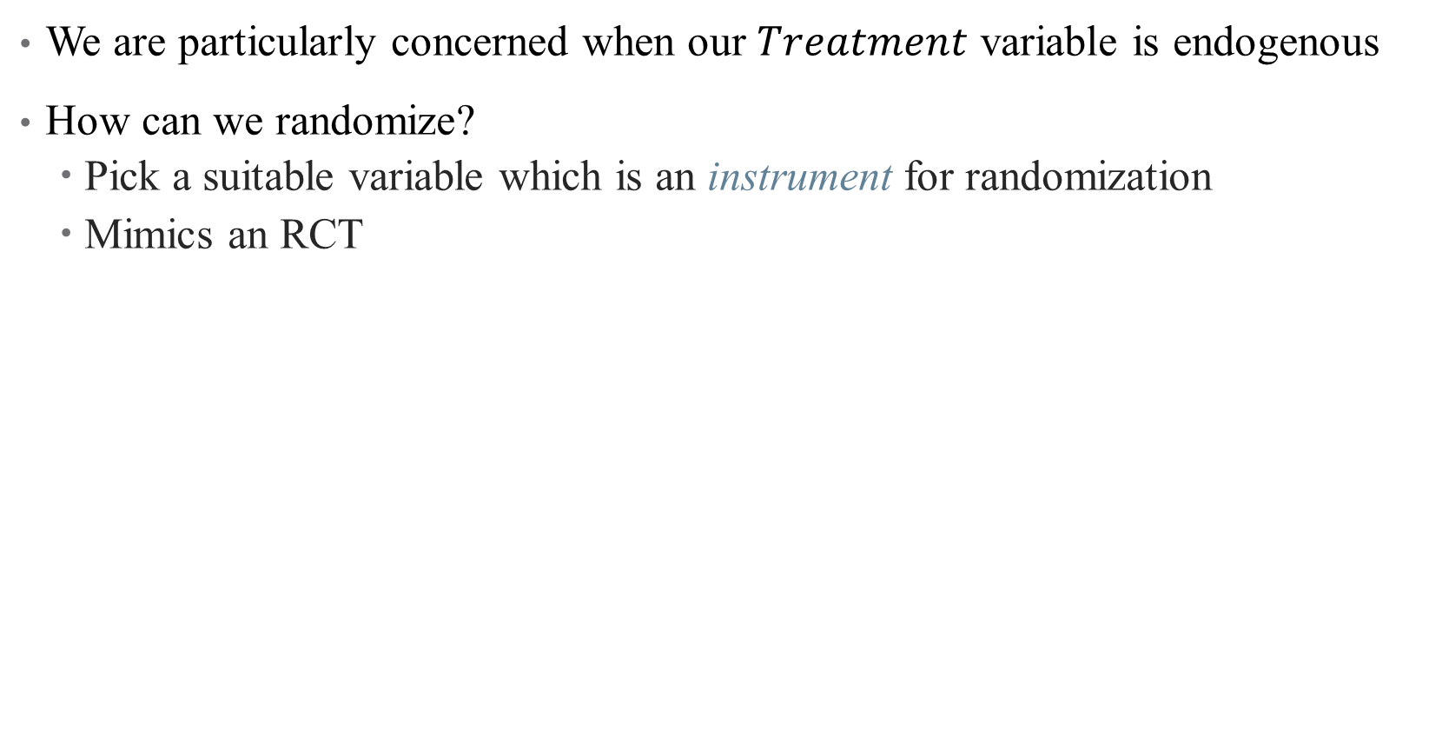
Instrumenting for an Endogenous Variable
We are particularly concerned when our $Treatment$ variable is endogenous
How can we randomize?
Pick a suitable variable which is an instrument for randomization
Mimics an RCT

Slide 30
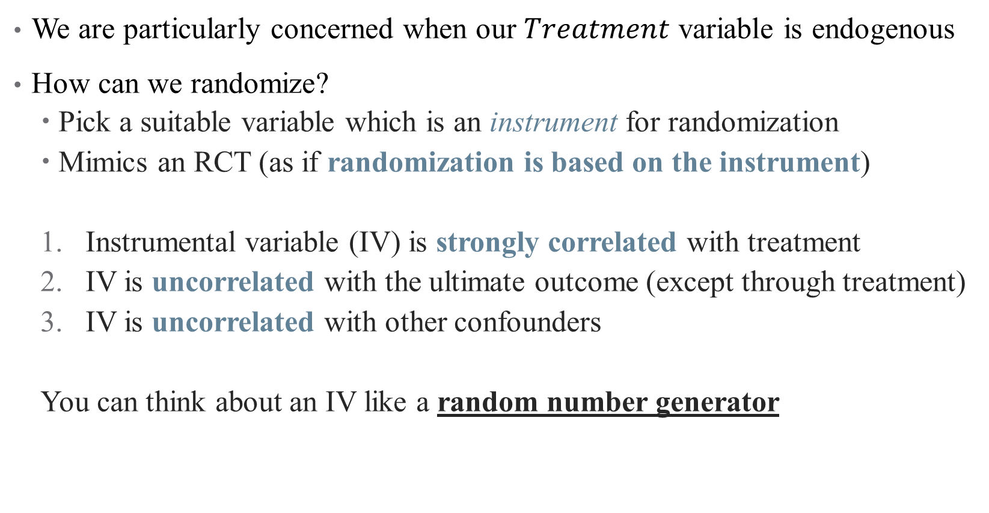
Instrumenting for an Endogenous Variable
We are particularly concerned when our $Treatment$ variable is endogenous
How can we randomize?
Pick a suitable variable which is an instrument for randomization
Mimics an RCT (as if randomization is based on the instrument)
Instrumental variable (IV) is strongly correlated with treatment
IV is uncorrelated with the ultimate outcome (except through treatment)
IV is uncorrelated with other confounders
You can think about an IV like a random number generator
Notes:
First condition is called relevance; second and third are validity – essentially that there are no open back doors of Z

Slide 31
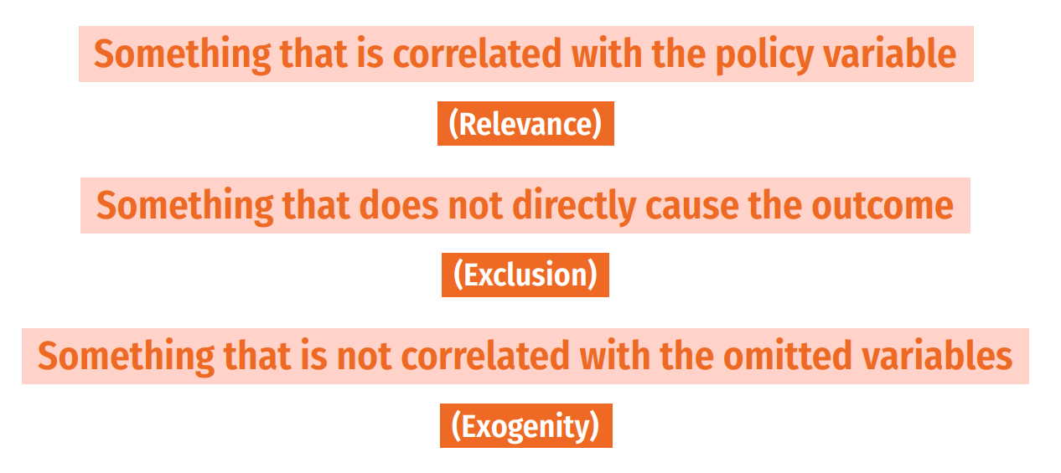
Instrumental Variables
Notes:
Another way to think about it

Slide 32
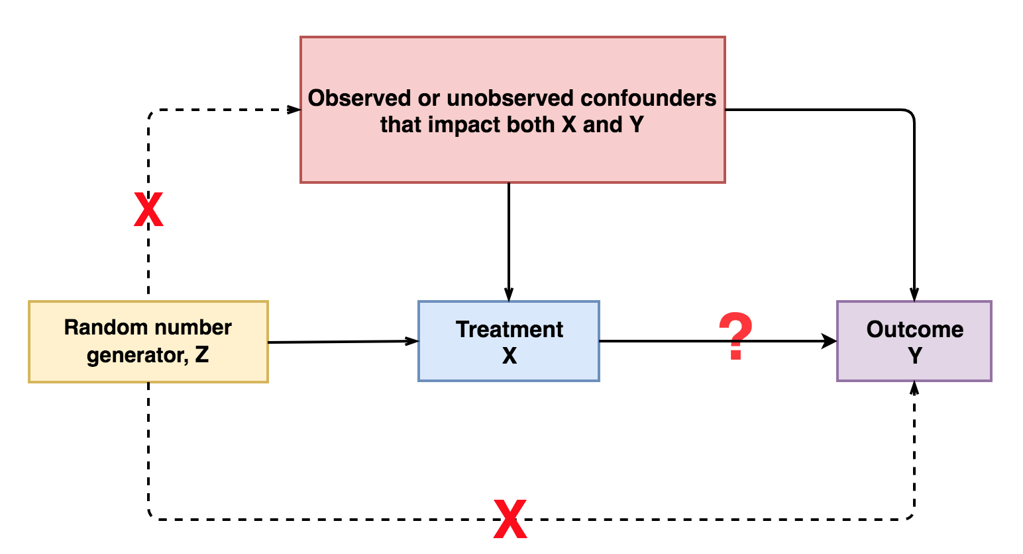
Notes:
Think first about just a random number generator. If that generator is used to assign treatment, then assumption 1 holds. If that random number isn’t used for anything else, then Z only affects Y through X (it doesn’t determine your pickiness or your age).

Slide 33
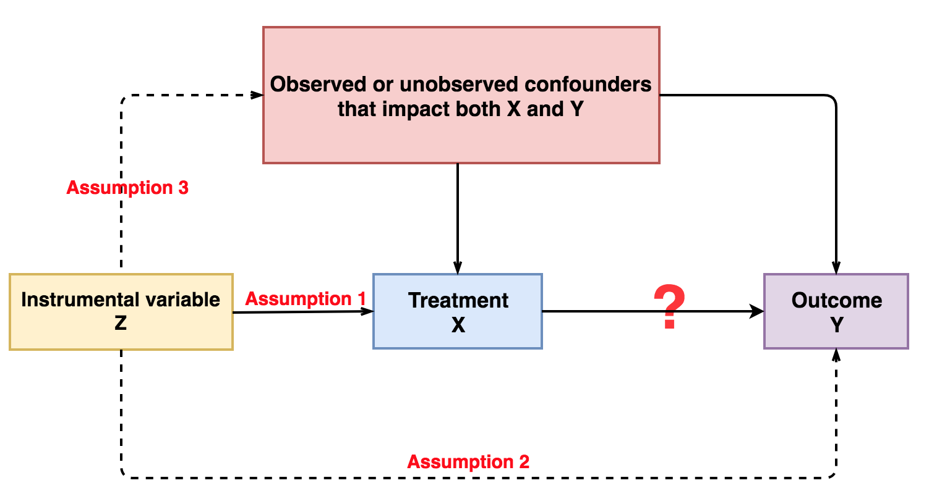
Notes:
So we want a variable like a random number generator. this is kind of the opposite of controlling for a variable: when we control for W, we use W to explain X and Y and remove those parts (to close a back door). But here, we are going to use Z as an instrument and remove the unexplained parts.

Slide 34
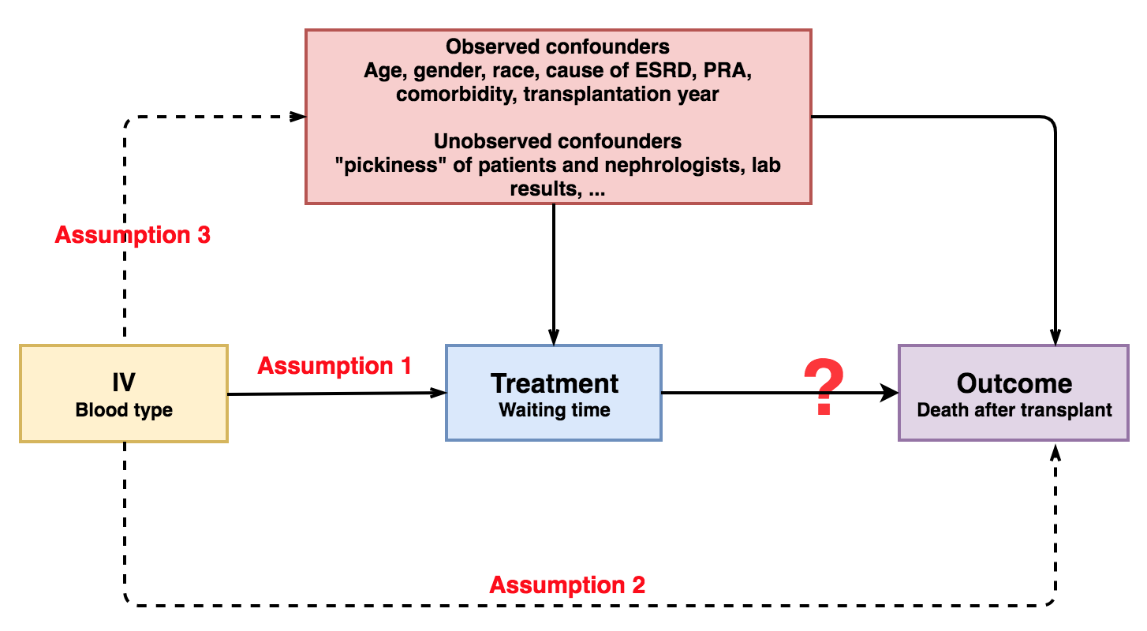
Example: Transfusions and Waiting Time
Consider blood type as a potential IV for waiting time
Notes:
Using our blood type example: Why is each assumption satisfied? Do we think this works? Can you think of any threats?

Slide 35
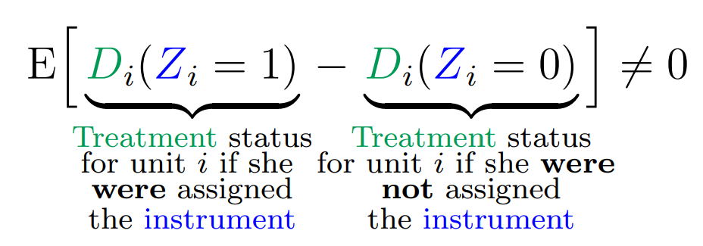
Instrumental Variables: Relevance
Notes:
Note: these come from really useful paper by Felton and Stewart. Now just for pedagogy, let’s do a completely different example and walk through it again. What is the effect of going back home (vs. moving) on recidivism. What is the open door? What are potential instruments? (ask this q even though it’s hard so that people can see the challenges of finding an IV)
Example of relevance: effect of going back home after prison on recidivism – use Hurricane Katrina in LA (does that change your decision to go home or not?)

Slide 36
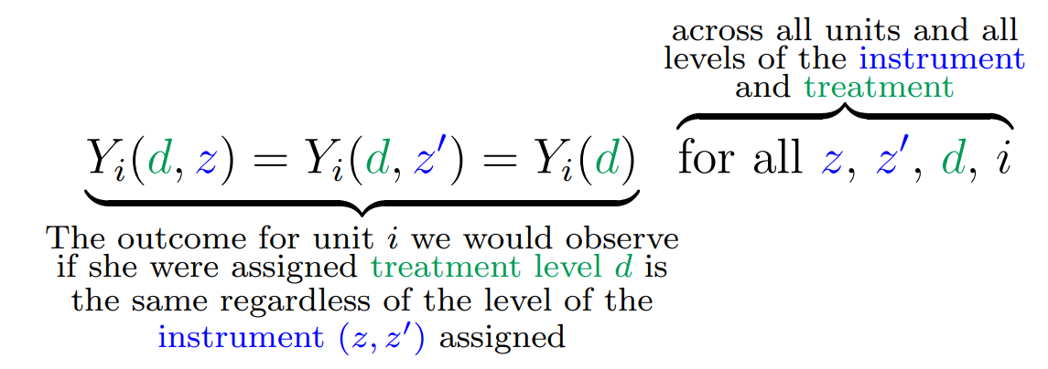
Instrumental Variables: Exclusion
Notes:
Example of exclusion: hurricane katrina can’t have affected recidivism in any other way except through residence change (can you think of violations to this?)

Slide 37
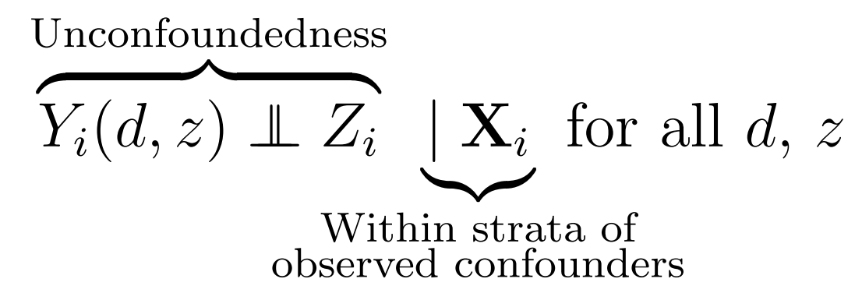
Instrumental Variables: Exogeneity
Notes:
Also called unconfoundedness. Note – treatment is confounded (that’s why we need IV in the first place) but hopefully IV isn’t. So if residence and recidivism are correlated (why would they be? Past history? Networks?), then Hurricane Katrina shouldn’t care about any of that

Slide 38
Instrumental Variable in our Example(s)
Notes:
Short version of the story here: we’re worried that FFS payments are making physicians overuse anemia drugs as a part of dialysis. In fact, OLS estimates of the effectiveness of these medicines suggest that anemia drugs make patients worse off! But there could be endogeneity in the physician use of dialysis. The IV the authors suggest is altitude, which is correlated with needing these drugs but not correlated with underlying physician decisions. They combine this with a DD to get at effects of a payment reform here. (We’ll talk about this in more detail through the semester).
Let’s walk through the assumptions here. Start with outcome variable (2), then exposure (bundled payment/use of drugs), then IV (altitude + post-bundle indicator). What endogeneity are they dealing with (strategic decision-making on the part of the doctors). Are the assumptions satisfied? (1. abstract says yes, altitude affects drug use; 2. altitude shouldn’t affect mortality or transfusion rates; 3. altitude shouldn’t affect strategy). Note that they use two IVs to get around this.
** This also shows that IVs can be (but don’t have to be!) scary **

Slide 39
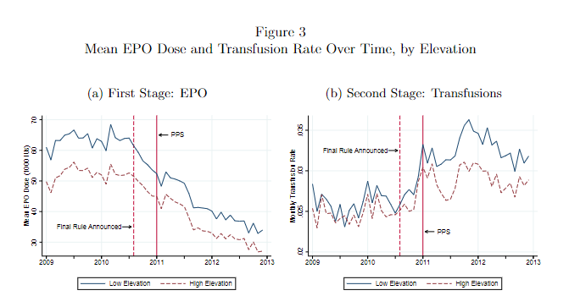
Notes:
Here’s the story of their two Ivs (why do they have a second one?)

Slide 40
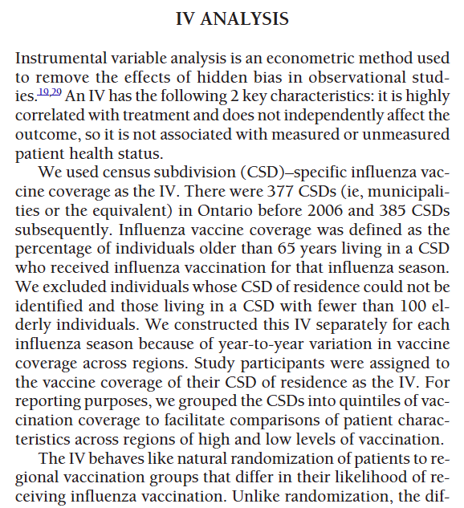
Instrumental Variable in our Example(s)
What did the authors of our case study use as their IV?
What’s the intuition? What variation is this picking up?
How does it “stack up” for you against the assumptions?
Notes:
This one is likely imperfect – what do you think? Can you use storytelling here (for or against)?
- Go through text in detail here.

Slide 41
Using IVs in Regression

Slide 42
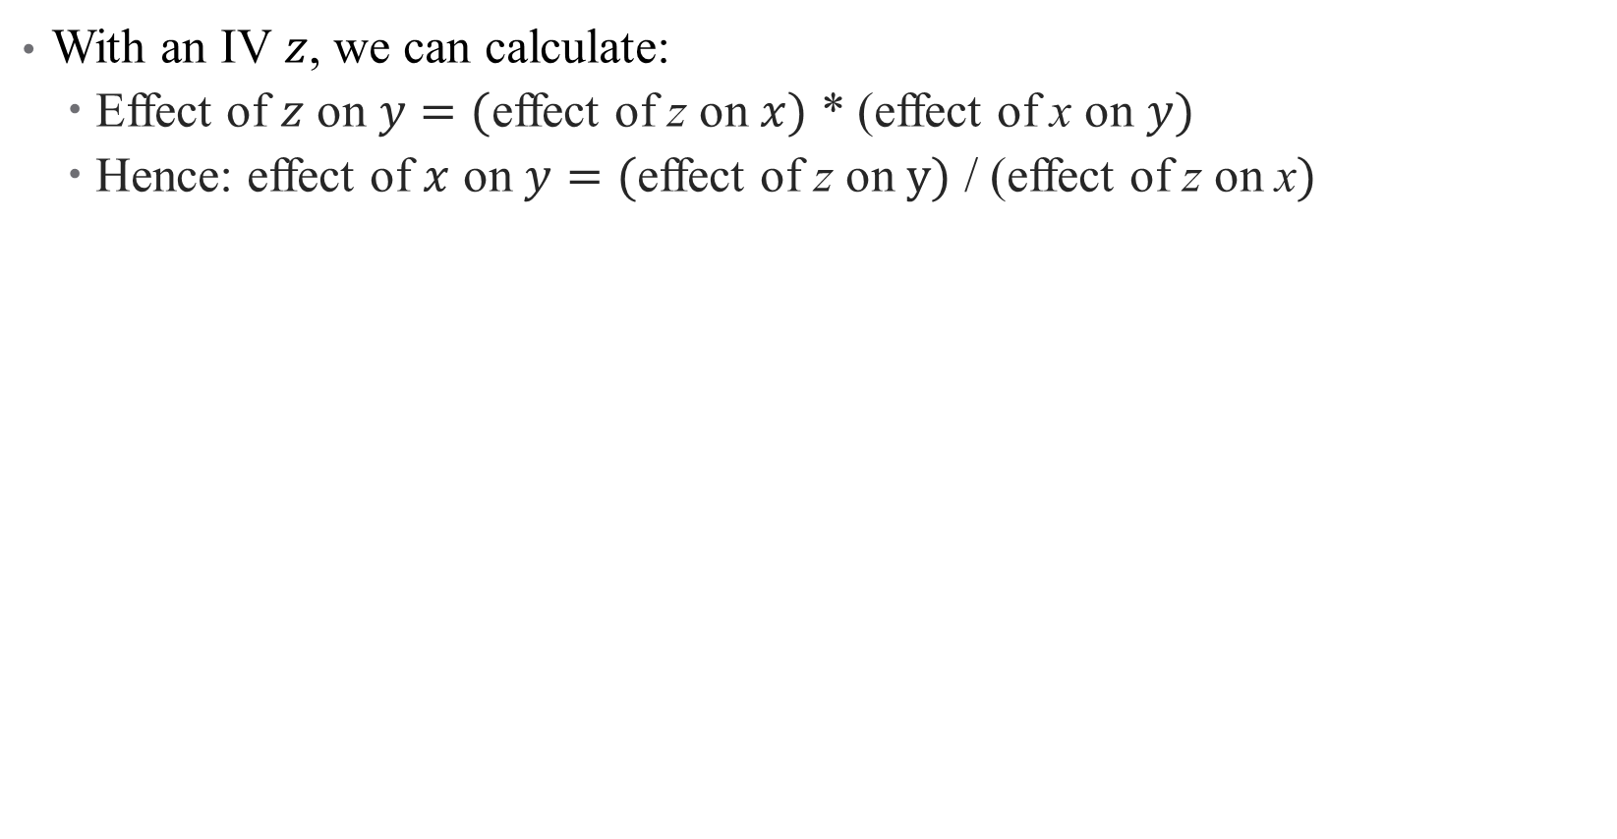
Using IVs to back out treatment effects
With an IV $z$, we can calculate:
Effect of $z$ on $y=($effect of z on $x)$ * (effect of x on $y)$
Hence: effect of $x$ on $y=($effect of z on $y)$ / (effect of z on x$)$

Slide 43

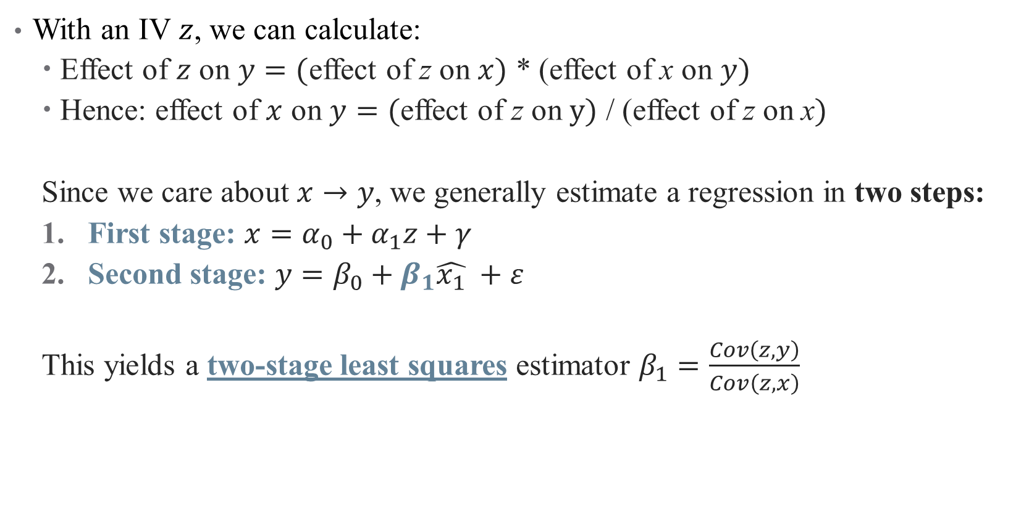
Using IVs to back out treatment effects
With an IV $z$, we can calculate:
Effect of $z$ on $y=($effect of z on $x)$ * (effect of x on $y)$
Hence: effect of $x$ on $y=($effect of z on $y)$ / (effect of z on x$)$
Since we care about $x→y$, we generally estimate a regression in two steps:
First stage: $x=α_{0}+α_{1}z+γ$
Second stage: $y=β_{0}+β_{1}\hat{x_{1}} +ε$
This yields a two-stage least squares estimator $β_{1}=\frac{Cov\left(z,y\right)}{Cov\left(z,x\right)}$
Notes:
Here, you can see why we need relevance condition; if Cov(z,x) = 0, then the 2sls doesn't return anything useful. Even if cov is small, we have problems (we'll return to this).

Slide 44
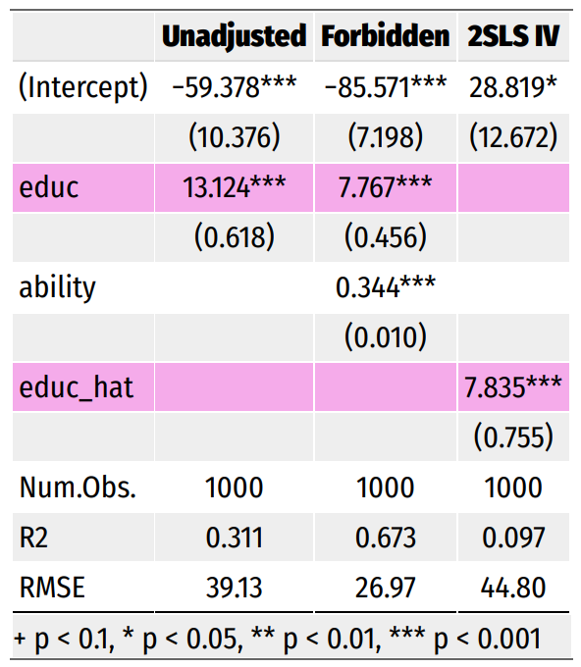
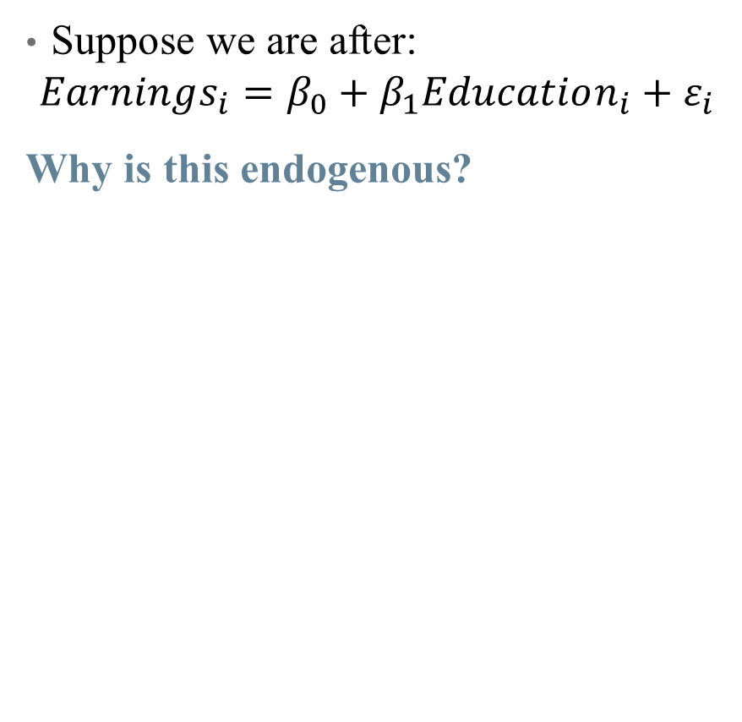
IV Regression: Illustration
Suppose we are after:
$$Earnings_{i}=β_{0}+β_{1}Education_{i}+ε_{i}$$
Why is this endogenous?
Notes:
Why is this endogenous? (We don’t have ability)

Slide 45
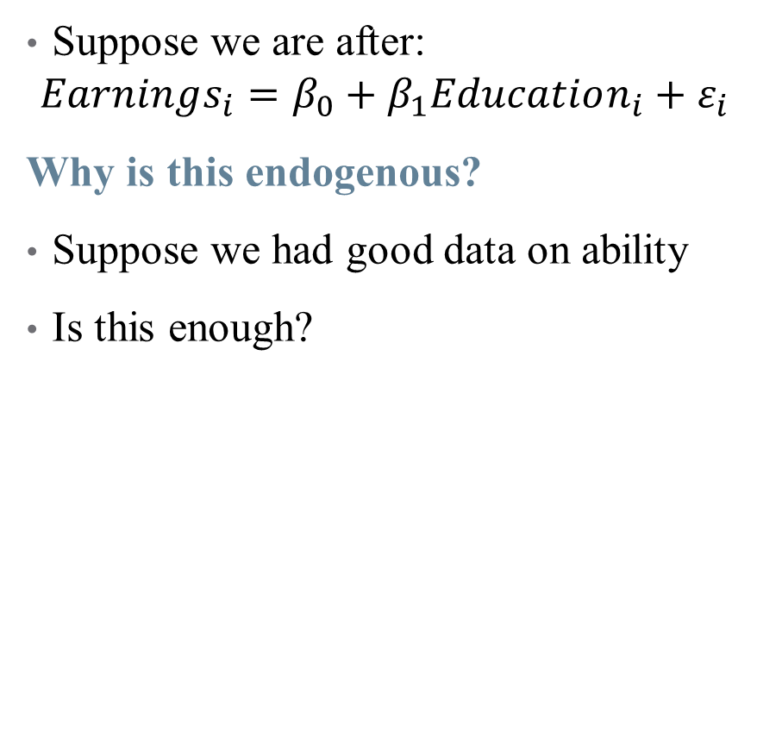
IV Regression: Illustration
Suppose we are after:
$$Earnings_{i}=β_{0}+β_{1}Education_{i}+ε_{i}$$
Why is this endogenous?
Suppose we had good data on ability
Is this enough?
Notes:
Yes, this is enough! We just can’t do this in the real world

Slide 46
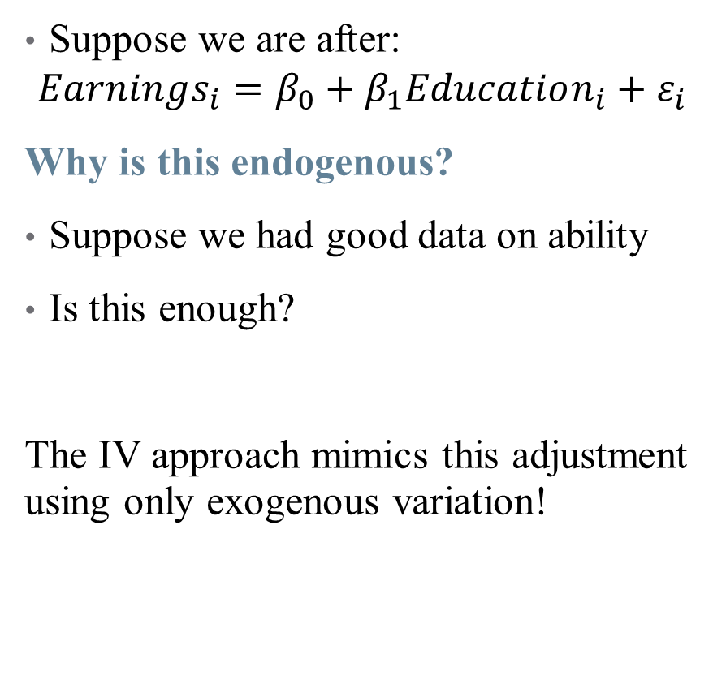
IV Regression: Illustration
Suppose we are after:
$$Earnings_{i}=β_{0}+β_{1}Education_{i}+ε_{i}$$
Why is this endogenous?
Suppose we had good data on ability
Is this enough?
The IV approach mimics this adjustment using only exogenous variation!
Notes:
In this case, the IV is your father’s education (a common but slightly dubious instrument – can talk about why if time). Note that the coefficient is the same sign but smaller (adjusting for positive selection into treatment). There are also cases where the coefficient may be opposite signed, especially if there is negative selection into a treatment with a positive treatment effect (as in the case study).

Slide 47
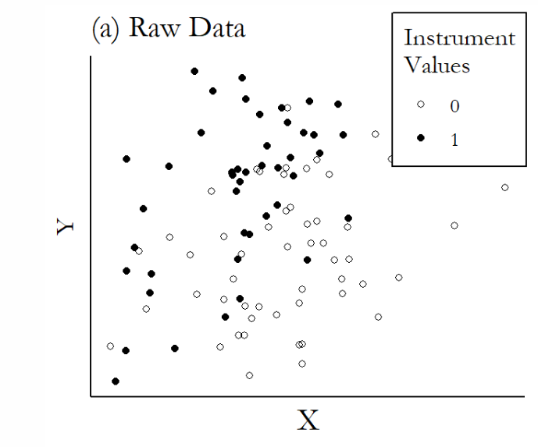
Graphical Illustration of IVs
Notes:
You can do these kind of quickly

Slide 48
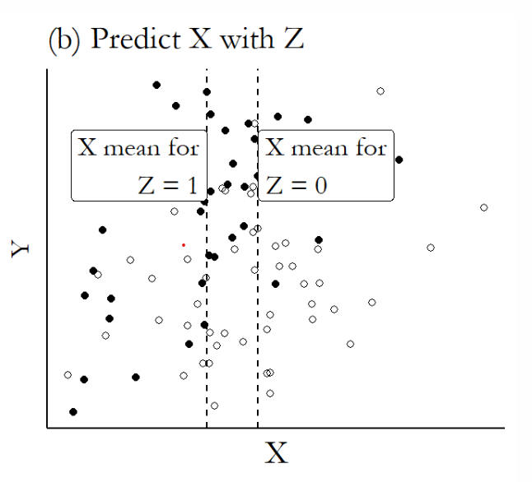
Graphical Illustration of IVs

Slide 49
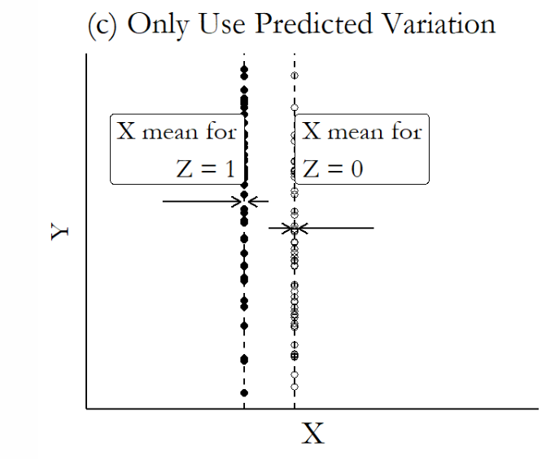
Graphical Illustration of IVs

Slide 50
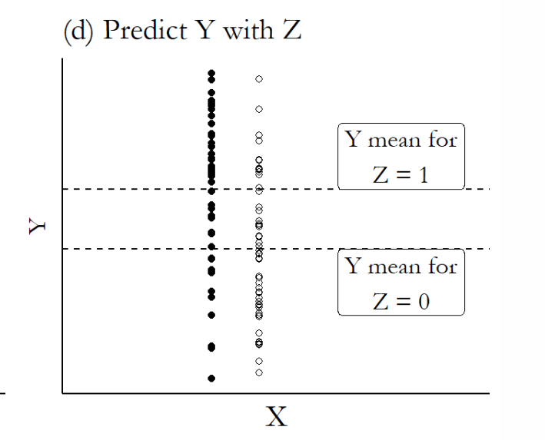
Graphical Illustration of IVs

Slide 51
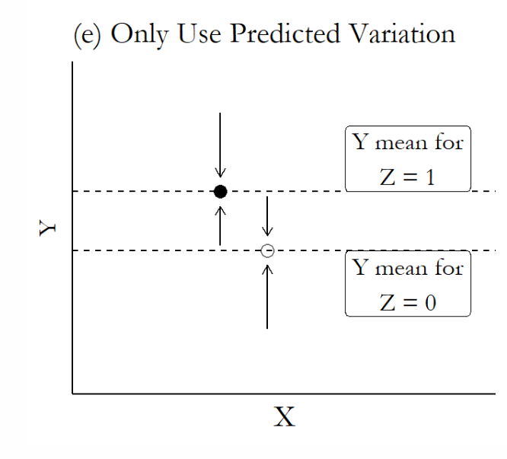
Graphical Illustration of IVs

Slide 52
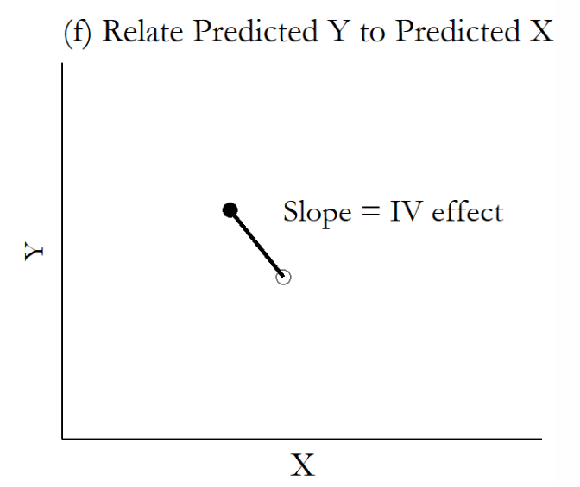
Graphical Illustration of IVs

Slide 53
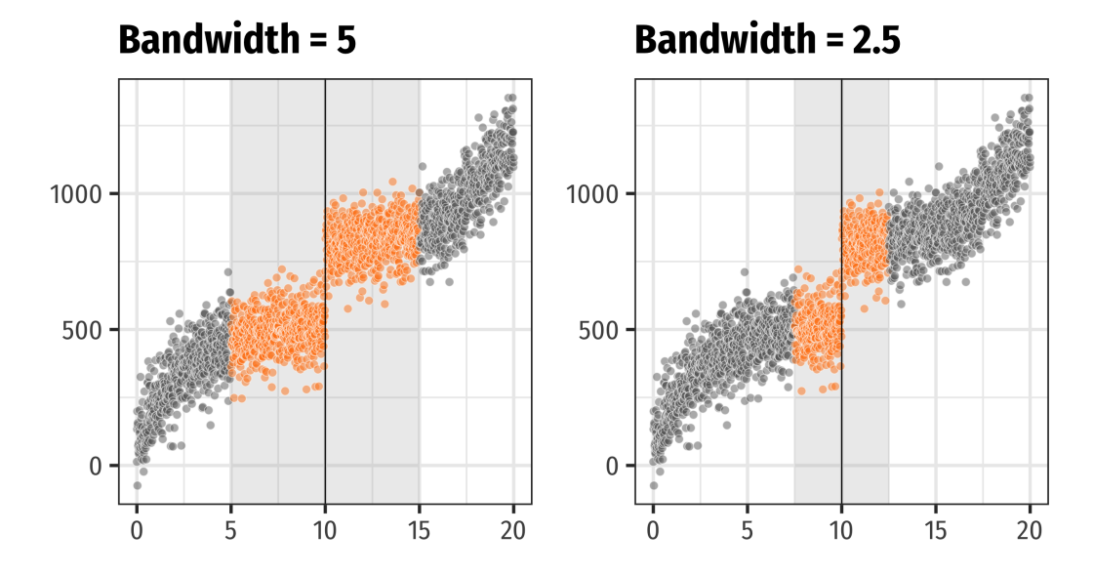
Using an IV: How do I interpret an IV?
IV's capture local average treatment effects (LATEs)
Notes:
Here’s a visualization of a LATE for a specific type of IV regression (fuzzy RDD, will do next semester). LATEs are just weighted ATEs that tell you something about a specific subset of the population (not the full pop)

Slide 54
Using an IV: How do I interpret an IV?
IV's capture local average treatment effects (LATEs)
Easiest to understand in the case of a binary instrument
 |  | Treated?
 |  | No | Yes
Instrumented? | No | Never-takers + Compliers | Always-takers + Defiers
 | Yes | Never-takers + Defiers | Always-takers + Compliers

Slide 55
Using an IV: How do I interpret an IV?
IV's capture local average treatment effects (LATEs)
The LATE from an IV is for compliers
Specifically, those influenced by the instruments you selected
Hence, LATE is instrument-specific
Notes:
So what is the LATE in our case study? Do we like it? Is it policy relevant?

Slide 56
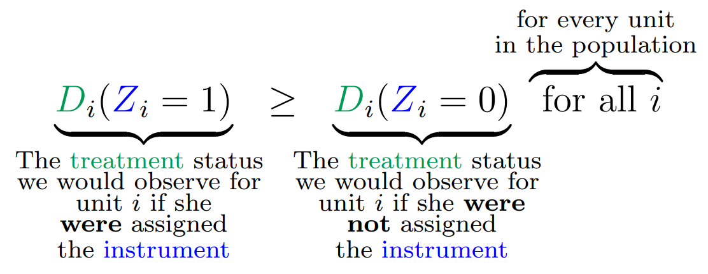
Using an IV: How do I interpret an IV?
IV's capture local average treatment effects (LATEs)
Easiest to understand in the case of a binary instrument:
IV identifies the treatment effect on those affected by the instrument
This does reduce the amount of variation/data used in identification
Identification rests on an assumption: no defiers (also called monotonicity)
Also, have to consider: is the LATE policy relevant? (ex: blood type)
Notes:
Monotonicity just means that the instrument moved people towards/away from treatment in the same way (an IV can't both incentivize treatment for one person and discourage it for another). Example of third child – is monotonicity satisfied here? Wrapped up in heterogeneous treatment effects.

Slide 57
Interpreting and Implementing IV
Notes:
Note: our case study gives you a light overview, but there is more here (which is why we will likely go through the dialysis paper in more depth)

Slide 58
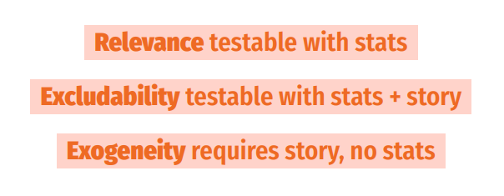
Using an IV: Testing Assumptions

Slide 59
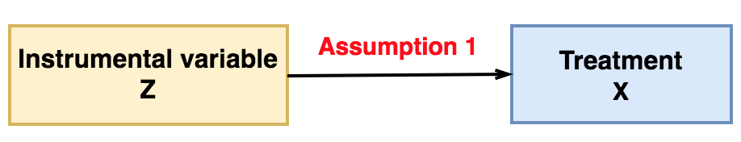
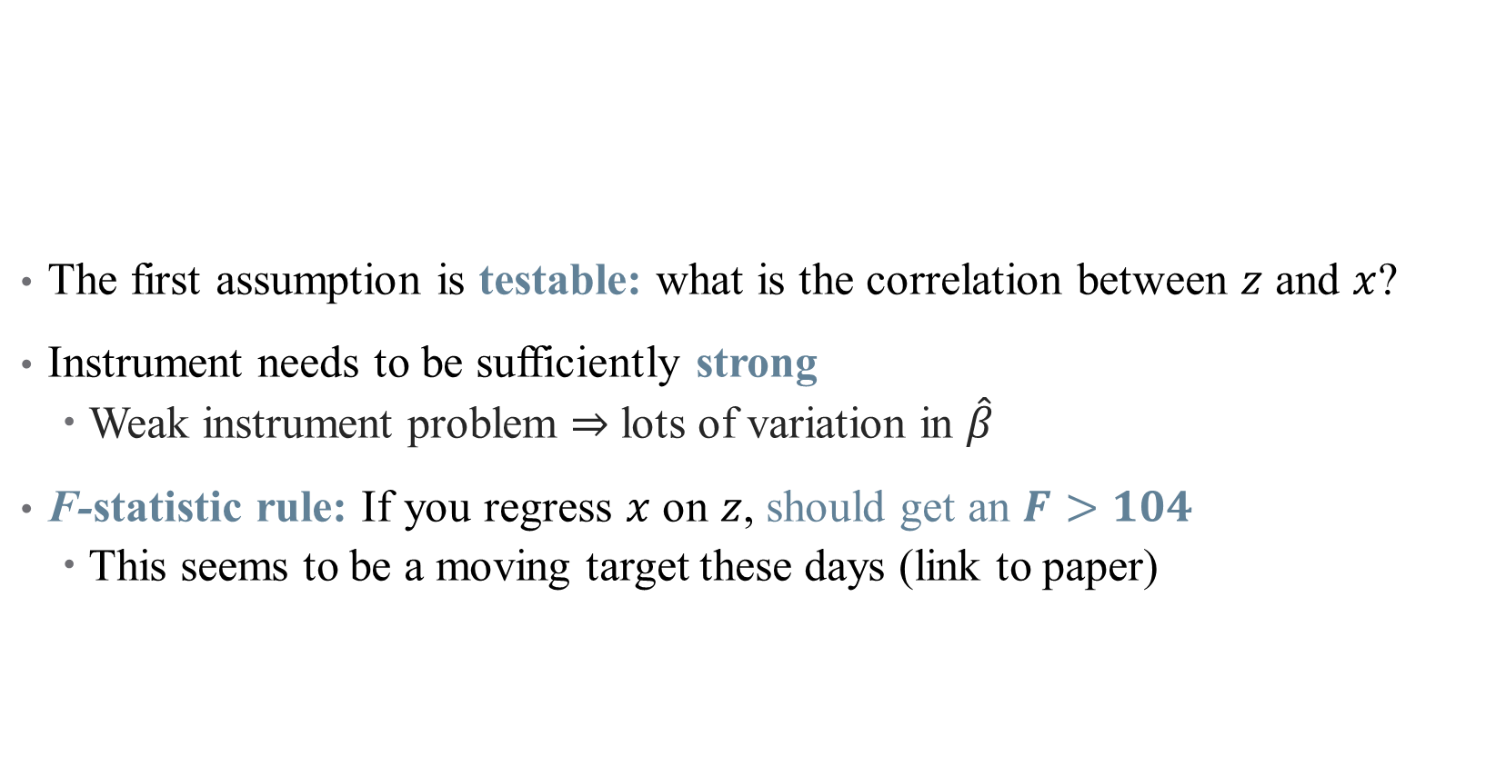
Using an IV: Testing Assumptions
The first assumption is testable: what is the correlation between $z$ and $x$?
Instrument needs to be sufficiently strong
Weak instrument problem $⇒$ lots of variation in $\hat{β}$
F-statistic rule: If you regress $x$ on $z$, should get an $F>104$
This seems to be a moving target these days (link to paper)
Notes:
You’ll have to talk about what an F stat is and how it relates to a t stat. See Felton and Stewart for what a weak IV can do, but basically exacerbates three problems: identification bias (parameter isn’t centered around truth), estimation bias (2SLS is “contaminated” by the confounding inherent in OLS, so 2SLS estimator gets “pulled” towards OLS estimator and away from truth), and Type M-error (publication bias – you have to have a super strong effect to have it show up significant with a weak IV; then, since insignificant estimates don’t get published, looking only at published work convinces you that the effect is *much* stronger than it really is)

Slide 60
Example of a First Stage Test
What are the two IVs actually used in practice? Why use two IVs?
What’s happening in this regression? What do we need to see here for our coefficients?
What’s the IV? Why are there a bunch of other controls?
Notes:
Here, we have altitude (cross-sectional variation) and the post-payment reform indicator variable (time series variation)

Slide 61
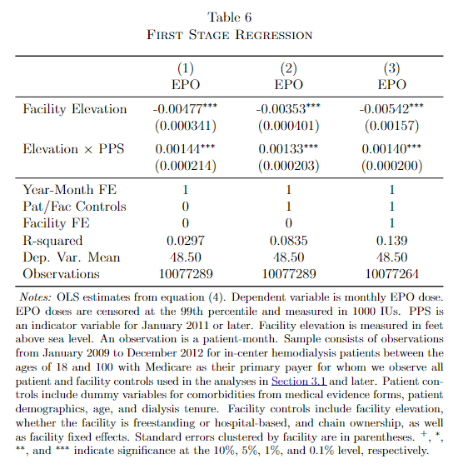
Example of a First Stage Test
What does this table tell us?
What’s missing?
Does this satisfy the first assumption?
Notes:
Where are the F-stats? The final F stat reported in the paper is ~50. They have a histogram in the paper that shows in general, this is the highest one they could get, but most are >10. How does that change interpretation?

Slide 62
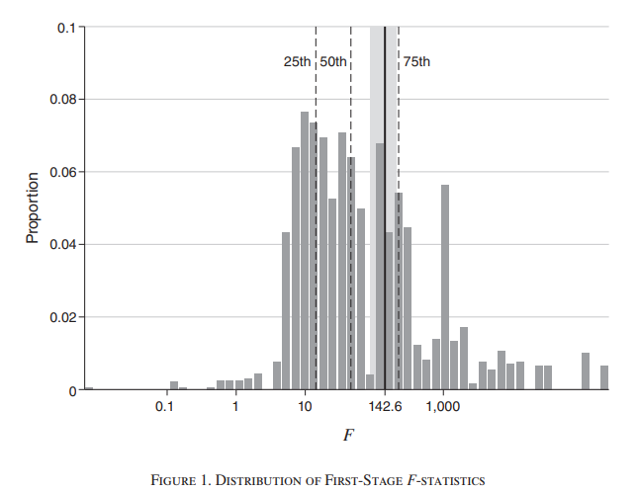
Current Research Alert: First-Stage Tests
Notes:
This comes from Lee et al, just published in AER this month. Here’s a log scale of the F-stats for IV papers in top econ journals (note scale is log). Most (75%) are bigger than 10, but not a lot get up to the new standard (here it’s slightly different). Thankfully, there is research linking the t stat with the F stat.

Slide 63


Using an IV: Testing Assumptions
The second assumption is not testable:
Why can’t we just regress $y$ on $z$ (even if we condition on x)?
Instead, need to argue something about randomness
What is the exclusion restriction in our case study?
“any other mechanism through which elevation affects patients is constant over time”
“any other mechanism causing health outcomes to differ before and after the payment reform affects patients uniformly with respect to elevation”
Why do we need two IVs here?
Notes:
What would happen if we were just using elevation as an IV? There are violations to the exclusion restriction (“we assume that the change in EPO was the only change that could have affected patient health”)! For example, “those living at higher elevations may have more-active lifestyles(e.g., hiking and skiing) that lead to better outcomes, or facilities may deliberately choose their location based on patients’ potential outcomes.”
The policy change alone isn’t enough (there were other trends going on such as updated dialysis standards – need to capture changes over time in nonlinear ways beyond just fixed effects)
The altitude alone isn’t enough (health effects from living in higher elevation). Hence, need to look at both!

Slide 64
Descriptive/Suggestive Evidence for Exclusion
What evidence do the authors give in favor of the exclusion restriction?
Notes:
What does this show? No real change in EPO doses (constant gap across elevation over time in panel (a)). Panel (b) shows larger effects for lower elevation for the payment reform.

Slide 65

Using an IV: Testing Assumptions
The third assumption is not testable:
No data on confounders in the first place!
Again, based on argument about why this assumption is satisfied
Notes:
What is done in this context? This is some of the stuff on omitted variables (confounders) and investment.
- The question here is: could the interacted instrument have done something to affect other confounders? What confounders might be important? Think patient and provider side.

Slide 66

Descriptive/Suggestive Evidence for Exogeneity
What evidence do the authors give in favor of the exogeneity restriction?
Difference-in-differences results for EPO doses and transfusions
Do omitted variables change disproportionately over time? (Look at OLS regression for “predicted mortality” variation across elevation before/after payment reform).
Notes:
Do these address your concerns? “Shows that predicted mortality doesn’t change across elevations, so that a changing mix of patients across elevations is unlikely to confound our estimates.” What else might there be?

Slide 67

Descriptive/Suggestive Evidence for Exogeneity
What evidence do the authors give in favor of the exogeneity restriction?
Difference-in-differences results for EPO doses and transfusions
Do omitted variables change disproportionately over time? (Look at OLS regression for “predicted mortality” variation across elevation before/after payment reform).
What if facilities reinvest additional profits from administering less EPO post-reform into quality-improving outcomes?
Notes:
Do these address your concerns? What else might there be?

Slide 68

IV Results
Notes:
Larger EPO doses should raise hemoglobin, that’s the point! So that’s a good check here. (Note the dependent variable mean to help put these into context). Now also more EPO doses have a declining effect on transfusions, which is in line with medical advice.

Slide 69

IV Results
Who are the people affected by this treatment effect? (What is the LATE? Who are the compliers?)
Notes:
What do we see here? Very limited effects on anything (some increases in mortality). the compliers — those patients whose EPO doses changed as a result of the instrument — had a 4.8% higher death rate during the pre-bundle period from excessive EPO doses. Note that power is low because of the potentially weak IV + few compliers in the sample. The number of observations here is generally a little misleading for 2SLS.
- Note that this is related to EPO doses, not the policy effect.

Slide 70

Other Popular IVs
Other popular IVs in the health literature (not exhaustive):
Distance (or differential distance) to hospital to account for patient-physician matching (Lee & Basu, 2025)
Quasi-random assignment to some providers (ambulances, ED docs, etc.; Doyle et al., 2015)
Differences in provider/physician preferences in treatment choices (sometimes called a “judge fixed effects” or leniency design)
Other policy changes (e.g., to OOP cost-sharing and negotiated insurer-provider prices; Dunn 2015; pharma SOP expansion as an IV for physician visits)
Genetic variants/Mendelian Randomization (Dixon et al, 2020; covered in biostats!)
Notes:
The basic DAG of an IV setup – can we pick one and walk me through it?

Slide 71
Other Example Papers and Instruments
The Effect of Evictions on Opioid Mortality (Bradford and Bradford, Health Services Research 2020)
Other popular (and more generalizable) IV approaches:
Lotteries: experiment with voluntary participation
Oregon Medicaid Experiment: Finkelstein, Amy, Sarah Taubman, Bill Wright, Mira Bernstein, Jonathan Gruber, Joseph P. Newhouse, Heidi Allen, and Katherine Baicker. 2012. “The Oregon Health Insurance Experiment: Evidence from the First Year.” Quarterly Journal of Economics 127 (3): 1057–1106.
Baicker, Katherine, Sarah L. Taubman, Heidi L. Allen, Mira Bernstein, Jonathan Gruber, Joseph Newhouse, Eric Schneider, Bill Wright, Alam Zaslavsky, and Amy Finkelstein. 2013. “The Oregon Experiment – Effects of Medicaid on Clinical Outcomes.” New England Journal of Medicine 368 (May): 1713–22.
Notes:
Example from 1: in the 2000s, Oregon chose to expand its Medicaid program for poor adults by making it more generous. They used a lottery – this randomization can be an IV to back out LATE from ITT.

Slide 72
Other Example Papers and Instruments
The Effect of Evictions on Opioid Mortality (Bradford and Bradford, Health Services Research 2020)
Other popular (and more generalizable) IV approaches:
2. Judge Fixed Effects (also called leniency designs)
Narrow pipeline through which all individuals must pass
Individuals are randomly assigned a decision-maker
Decision-maker has discretion over final outcome
Then, random "judge" assignment can be used to instrument for outcomes
What are some health policy examples of this? Are they valid?
Bakx, Wouterse, van Doorslaer, and Wong (2020, JHE): "Better off at home? Effects of nursing home eligibility on costs, hospitalizations and survival"
Notes:
This is just really popular with judges, doesn't have to be criminal. Possible examples: FDA approval, physician decision-making. Some concerns: is assignment truly random? Is the pipeline really narrow? Can the discretion be chosen by the patient/entity? Paper uses differences in nursing home eligibility assessors to find that access to nursing homes lowers use of other kinds of care, but does not affect health spending or mortality meaningfully. Plenty of opportunities to implement this design more meaningfully.

Slide 73
Other Example Papers and Instruments
The Effect of Evictions on Opioid Mortality (Bradford and Bradford, Health Services Research 2020)
Other popular (and more generalizable) IV approaches:
3. Bartik/Shift-Share Instruments
A type of instrument which measures change in a region’s labor demand due to changes in the national demand for different industries’ products
Created by interacting initial “shares” of geographic regions with national growth rates (in immigration, manufacturing employment, etc.)
Example: Currie, Jin, and Schnell (2019): "U.S. Employment and Opioids: Is there a Connection?," Working paper.
Notes:
This is most useful when looking at regional market differences in health questions.

Slide 74


Other Example Papers and Instruments
4. Policies can be an IV (under certain conditions!)
Example: policy expanding pharmacist scope of practice as an IV for foot traffic to outpatient/emergency care
First stage
Second stage
Notes:
https://www.sciencedirect.com/science/article/pii/S0167629625000864?via%3Dihub

Slide 75
Some IV Best Practices

Slide 76

Using an IV: How do I come up with an IV?
Notes:
Instruments have to be weird!

Slide 77
Using an IV: How do I come up with an IV?
It is unlikely that any personal characteristic can be used as a strong instrumental variable
Most good instruments come from:
Real randomization (blood type)
“Mendelian randomization”: parent genes produce "random" children
Unexpected correlations – a variable you would never expect had anything to do with assigning treatment ("a good instrument should feel weird")
Think about regional characteristics (unemployment rate), policies (blood type; cigarette tax), “natural” features (proximity)
Clever instruments are likely to be extremely context-dependent!
Notes:
Example for Mendelian randomization: the sex of first two children determines whether parents are more likely to have a third child.

Slide 78
Using an IV: How do I defend an IV?
Report relevance:
Used to be F > 10, now is F > 104.7
Notes:
Large F stat is just for correcting t-tests for relationship between X and Y and X and Z – your CIs will be a tiny bit wrong. Generally, a large F will work (although closer to 10 still gives you problems). Remember that this is a scale, since we're concerned about weak instruments

Slide 79
Using an IV: How do I defend an IV?
Report relevance:
Used to be F > 10, now is F > 104.7
Correct for weak instrument problems
There are bias correction tests and methods
These corrections aren't universally accepted
Generally, they blow up your standard errors too much to be useful anyway
Notes:
Skip code if time?

Slide 80

Using an IV: How do I defend an IV?
Report relevance:
Used to be F > 10, now is F > 104.7
Correct for weak instrument problems
There are bias correction tests and methods
These corrections aren't universally accepted
Generally, they blow up your standard errors too much to be useful anyway
Defend validity
Hard to justify $Z$ isn't related to $Y$ at all except through $X$
Example: blood type might be related to risk of infetions (COVID)
There are tests, but nobody really buys them – this one is all in the story
Notes:
Difficulty with defending validity just means that we need to be choosy, not give up on IV altogether. It's just like trying to convince a room your DAG is right! And bulk of evidence helps, here (many studies with different approaches)

Slide 81


What about covariates?
Notes:
This is cutting-edge research here – if you need to include controls, there is a “right” way to do that that is “fully saturated” with the controls included nonparametrically in both the first and second stage (which has its own tradeoff: many instrument bias). This isn’t done commonly in practice! May help to know about this and show robustness to both options.

Slide 82
Using an IV: What if I can’t defend my IV?
Many quasi-experimental approaches are very assumption dependent
IV is no exception!
Notes:
Come from Felton and Stewart (they call IV “fragile” – I don’t like that, it’s just kind of a “you get what you put into it” kind of thing – we’re doing QE variation with observational data, so there are limitations. Just need to be aware of them and report them honestly)

Slide 83
Using an IV: What if I can’t defend my IV?
Many quasi-experimental approaches are very assumption dependent
IV is no exception!
Some things to be aware of:
IV is (more) biased if you condition on post-instrument variables
IV must match measured treatments, not true treatment
Weak IVs can exacerbate even trivial assumption violations!
Small sample bias – your assumptions might be statistically violated at random
Notes:
Examples: can’t control for changes in employment post Hurricane Katrina (downstream outcome; we’ll talk about this one a lot in the course). Coarsened treatments are another example – if you have an IV that changes how people behave in Toronto but not North York, but then you only observe data for the whole GTA, this won’t work

Slide 84
Conclusion
IV is a powerful design when data suffer from selection on unobservables.
Good front door approach!
Has limitations:
First, it only identifies the LATE, which may or may not be policy relevant
IV has up to five (untestable) assumptions!
IV tends to be less credible generally (too many unknowns)
But IV is an important strategy and sometimes the opportunity to use it will come along!
Build in-depth knowledge of institutional details -- familiarity is how you find instruments!
Notes:
There are other slides after this for “extra” material, cover only if you have time.

Slide 85


Using an IV: What if I can’t defend my IV?
Notes:
Everyone should be following Khoa (Kwaa). If everything goes perfectly, IV is “approximately” unbiased – the biggest problem comes from weak instruments.

Slide 86

Weak IV Bias
Notes:
Cover this if you have time. Results from a Monte Carlo survey (sorry for gross blue background). Suppose we have 20 IVS but only one is useful. If true coefficient is 1, these are bias of different approaches (note you’re better off just using the one true coefficient!)

Slide 87

Using an IV: Best Practices
Notes:
Cover this if you have time. From Felton and Stewart (2022). One not on here: always use packages to get standard errors right

Slide 88

Using an IV: Best Practices
Notes:
Skipping over 3 because I don’t believe it (it says to assume the most conservative SE and report multiple Ses – I think you should pick your choice theoretically and use that one)

Slide 89
Other Example Papers and Instruments
The Effect of Evictions on Opioid Mortality (Bradford and Bradford, Health Services Research 2020)
Notes:
Kind of a standard IV paper, good clinical journal style to read and mimic

Slide 90
Conclusion
IV is a powerful design when data suffer from selection on unobservables.
Good front door approach!
Has limitations:
First, it only identifies the LATE, which may or may not be policy relevant
IV has up to five (untestable) assumptions!
IV tends to be less credible generally (too many unknowns)
But IV is an important strategy and sometimes the opportunity to use it will come along!
Build in-depth knowledge of institutional details -- familiarity is how you find instruments!
Notes:
This is most useful when looking at regional market differences in health questions.

